Slide 1

Building Your First VR App

Slide 2
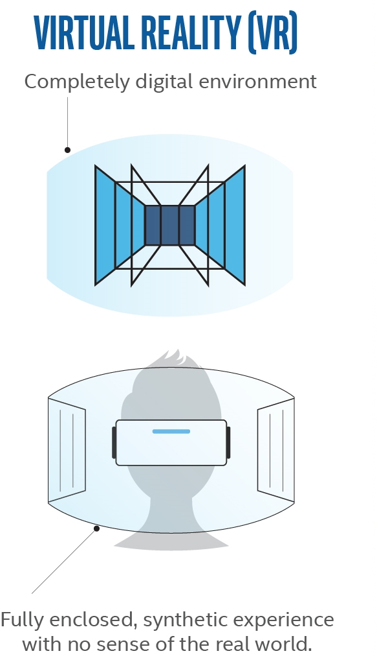

What is Virtual Reality?
Notes:
What is VR – a completely digital environment

Slide 3
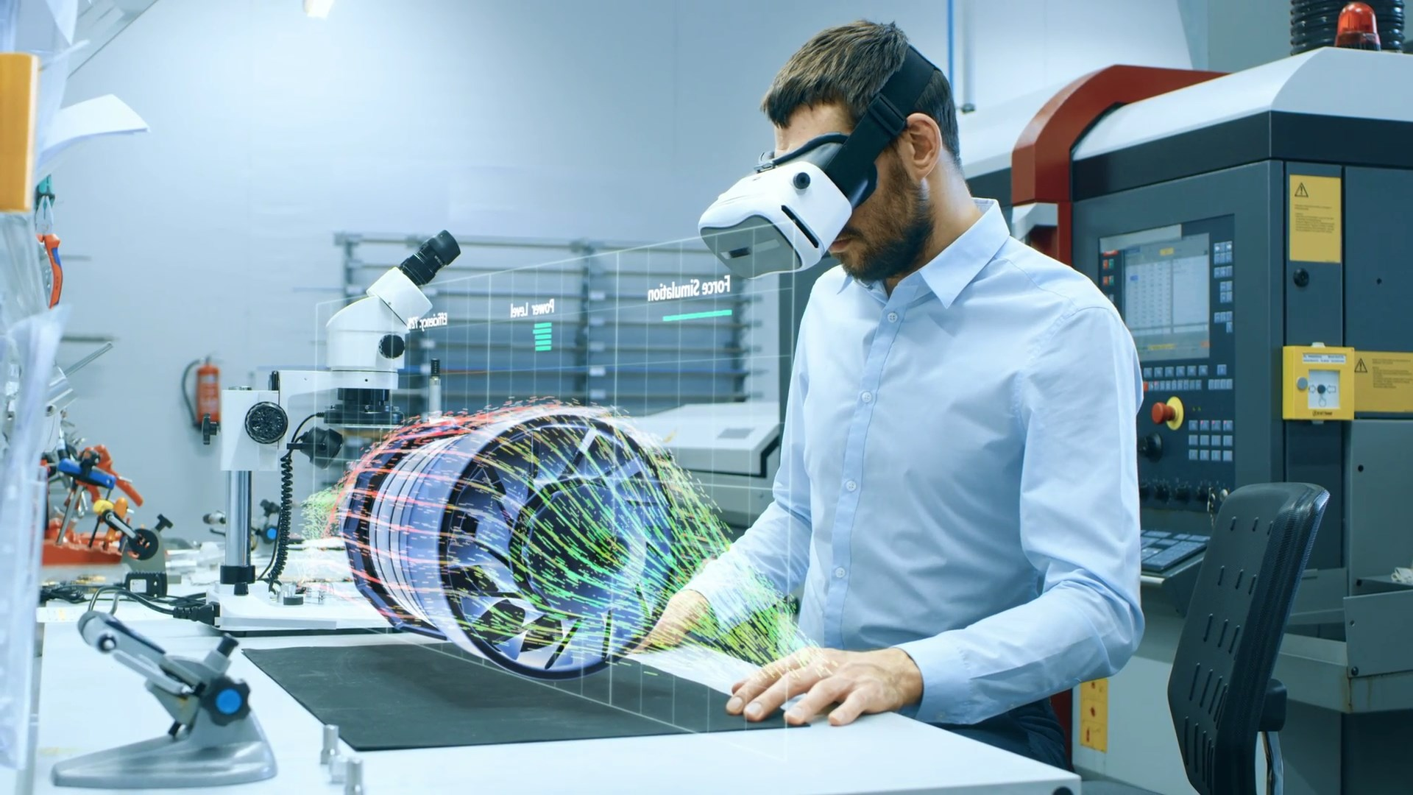
VR for Business – 3D model viewing
Notes:
VR already in business – engineering analyzing a 3D model in world scale

Slide 4
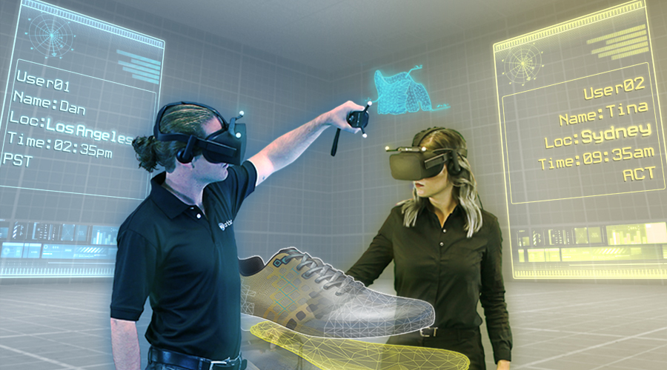
VR for Business – immersive 3D design
Notes:
VR in business – immersive collaborative design

Slide 5
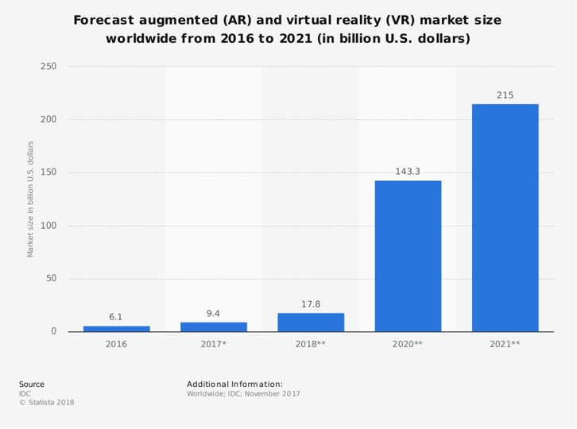
AR/VR Market Potential
Notes:
Projected market size
This is the cumulative size, including hardware, software and content

Slide 6
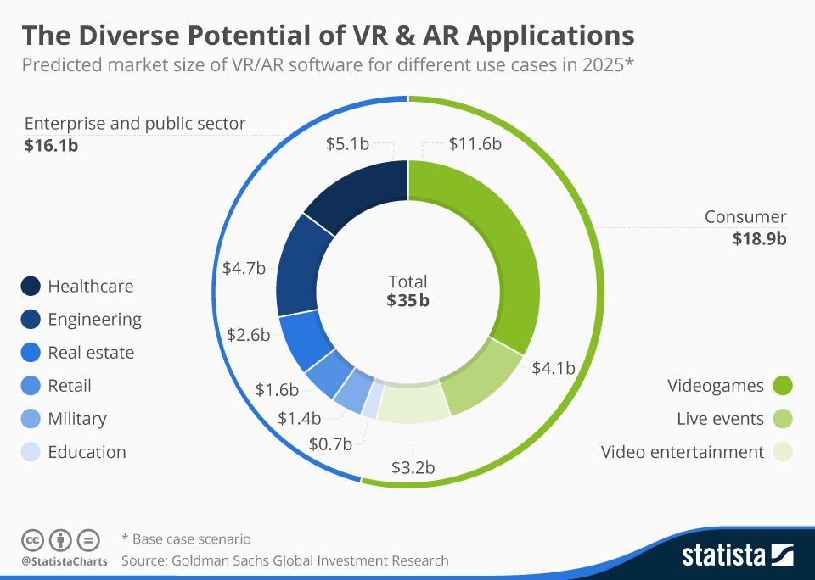
AR/VR software is soon to become a mainstream $35 billion market. It will be a major stake in the business applications of tomorrow
Notes:
Software is going to be 35 billion

Slide 7



Why VR for Business?
Realistic Experiences
Uncharted Territory
Engaging Collaboration
Notes:
Realistic experiences
Stereoscopic 3D makes every VR experience realistic and memorable.
This greatly improves even simple business processes.
Uncharted territory
VR is still in its infancy and is ideal for future-looking businesses to create competitive advantage.
Engaging collaboration
Efficient teams are the most important asset of every business. VR takes collaboration to a whole new level.

Slide 8
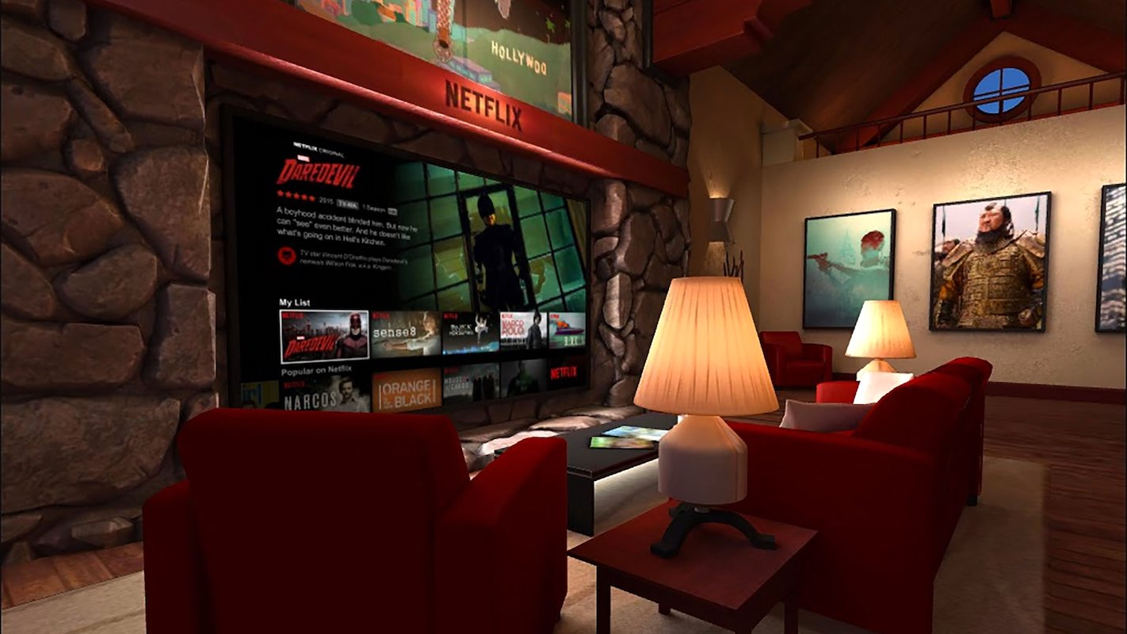
What is a VR App?
Notes:
What is a VR application?
Regardless of whether this is a game or a business application, in its essence, every VR application is a 3D game. The gameplay depends on the target user but the development principles are the same. So, to develop a VR app we need a gaming engine. We picked Unity3D for many reasons, the most important ones being simplicity and true cross-platform support.

Slide 9
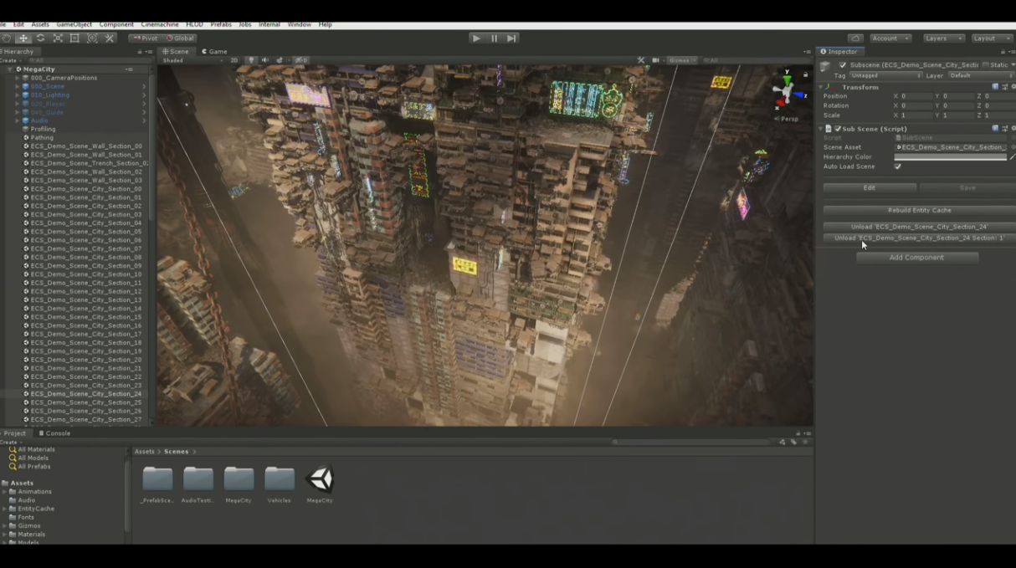
What is Unity3D?
Notes:
Brief overview of Unity3D
A gaming engine and an IDE for creating, designing and scripting games
Truly cross-platform – supports any existing mobile, desktop and AR/VR device
Scripting language is C#
Continuously optimizing on performance, now on par with UE in many aspects

Slide 10
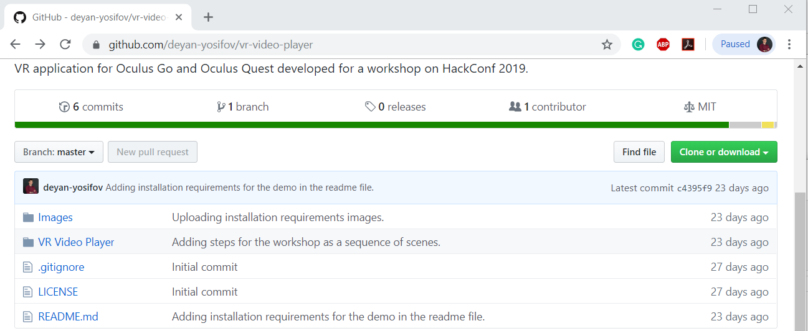
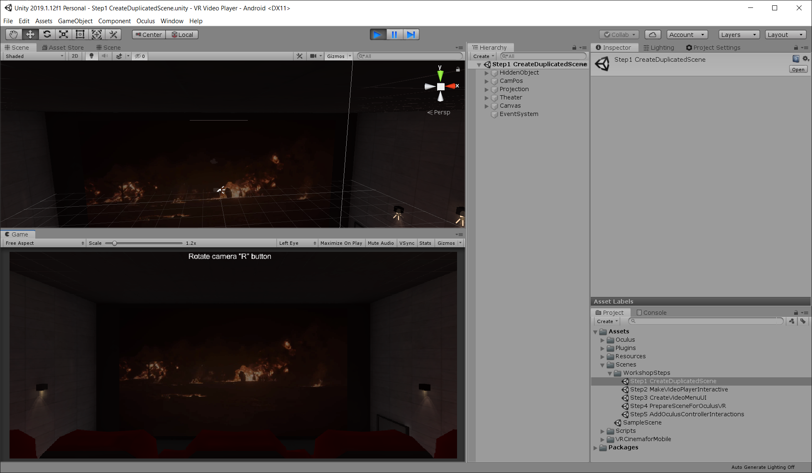
Overview of the workshop
10 minutes
Notes:
Describe what is the application and the steps that we will go through. Explain how the project is structured and how it is intended to be used – each step has a separate scene that can be used if something goes wrong or the time is not enough. Define the flow of the workshop and how we will work in each step. The idea is to start a clean new scene and by following the steps that we will go through to come-up with the final version of the demo.

Slide 11
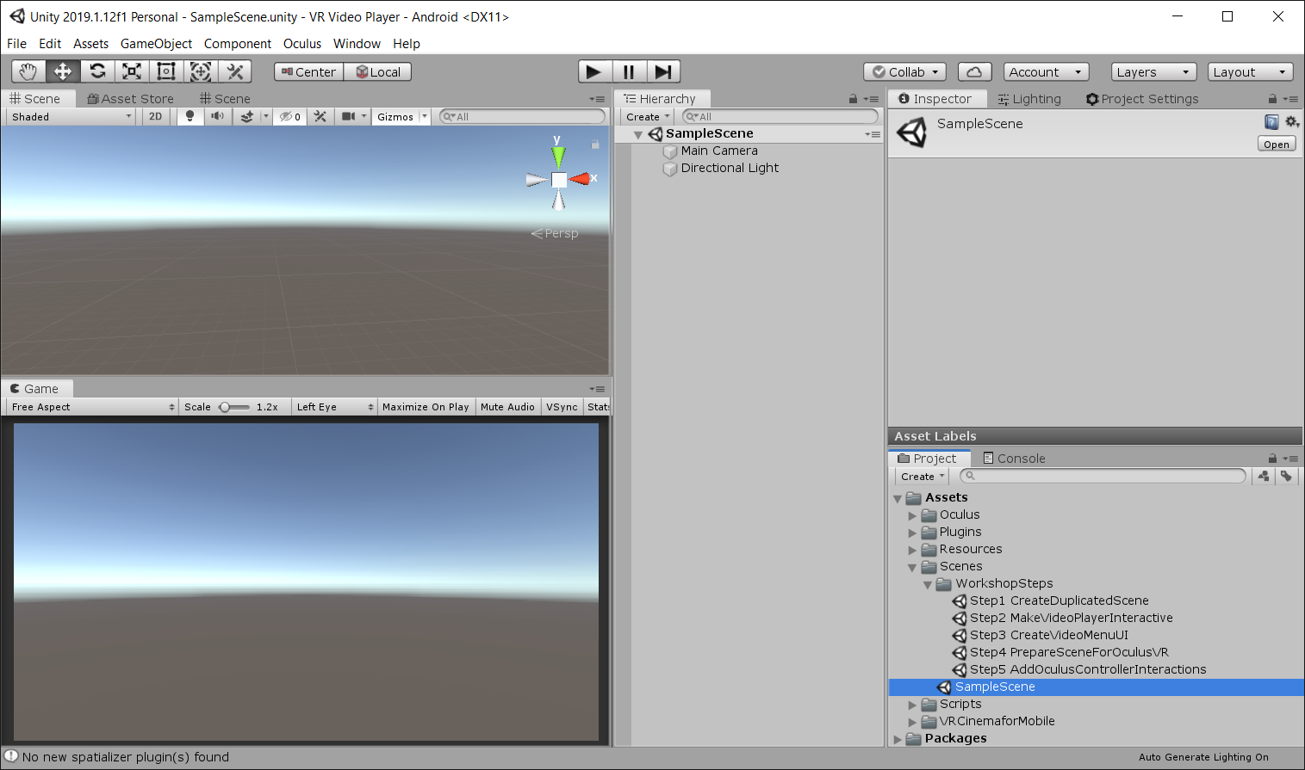
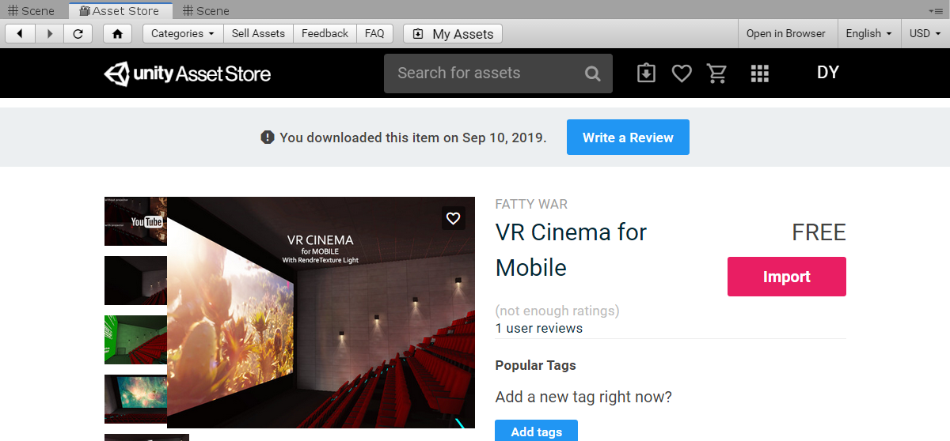
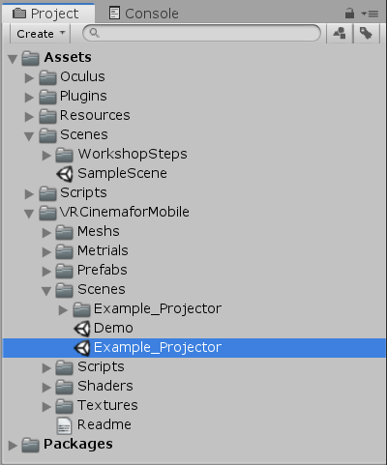
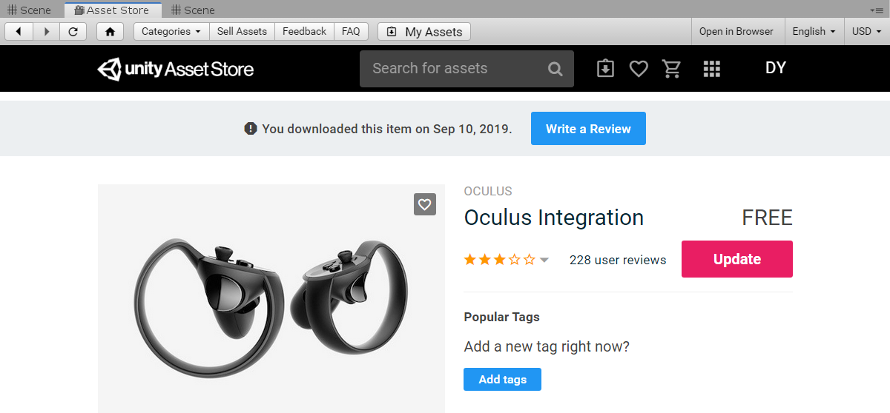
1.
Setting-up the environment
15 minutes
Notes:
The steps needed to create the environment of the Theater room:
- Open SampleScene to see how a default Unity scene looks like.
- Explain about Hierarchy, Scene, Game, Project, Inspector and Console windows in Unity Editor.
- Look in Asset store and show the pre-imported assets “Oculus Integration” and “VR Cinema for Mobile”
- See “Example_Projector” demo scene and duplicate it so that we may start our development from it.

Slide 12
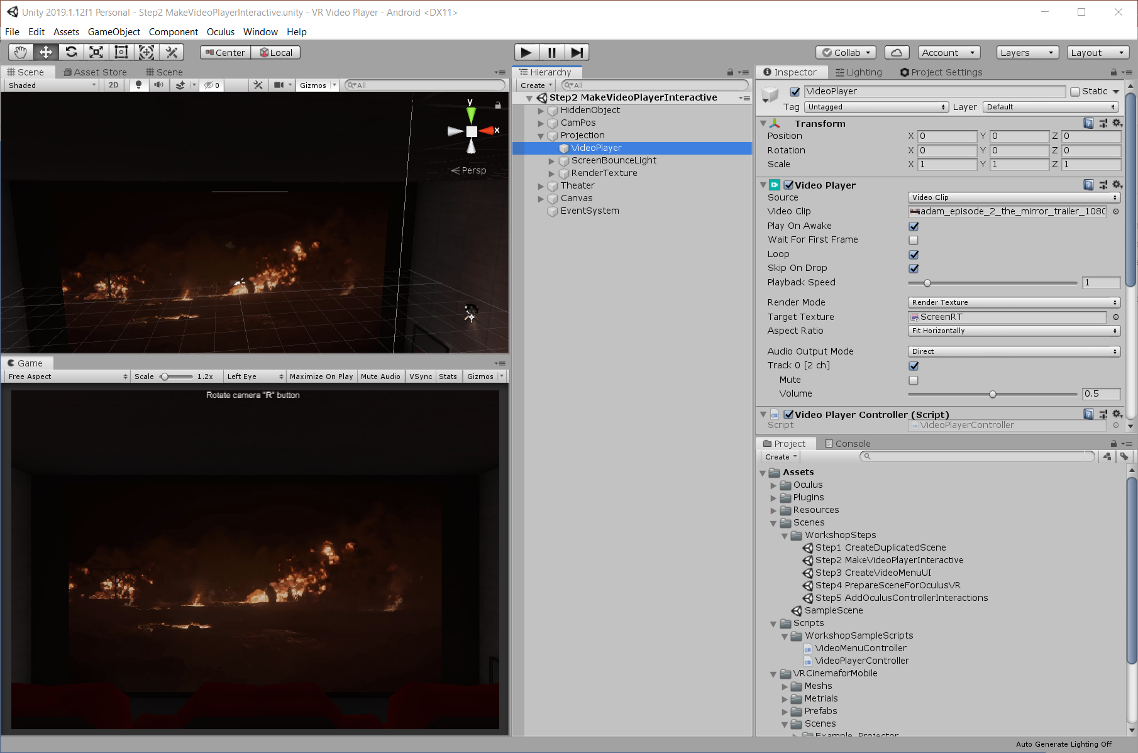
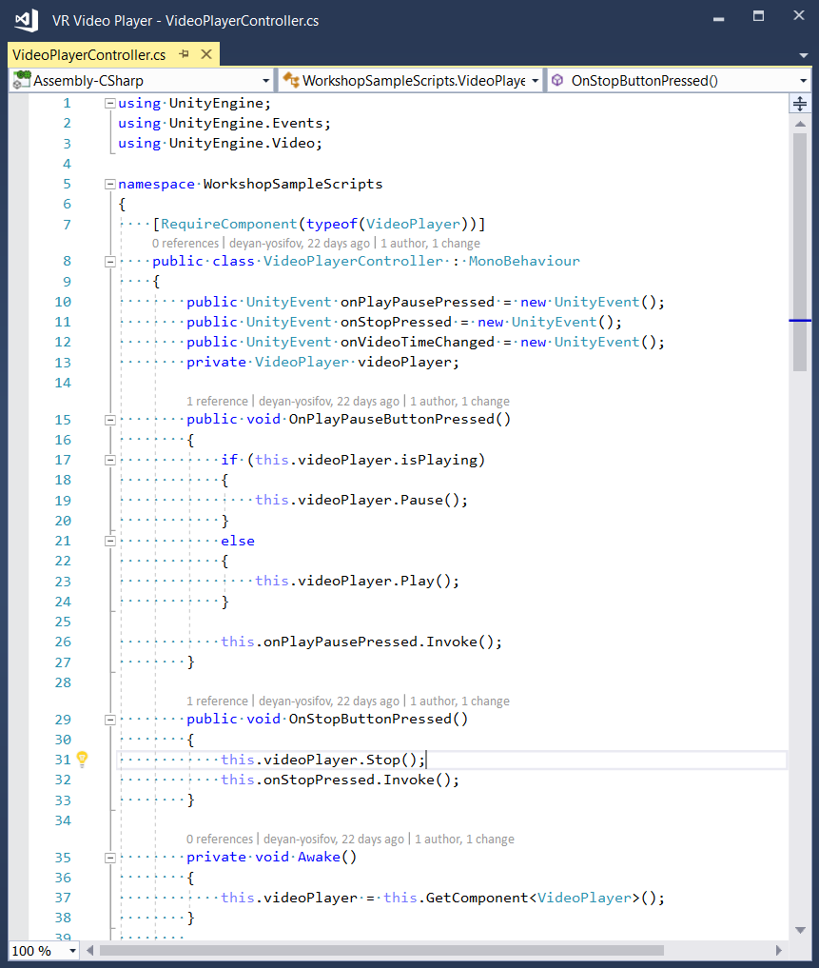
2.
Setting-up the video screen
20 minutes
Notes:
Look at the VideoPlayer object and write a script that can control the video with the keyboard.
- Create VideoPlayerController script that will handle keyboard input.
- Implement Play, Pause, Move Forward and Move Backward video functionalities.
- Test the functionalities playing the Game Window.

Slide 13
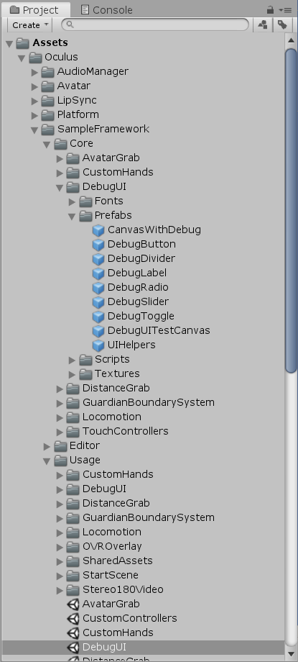
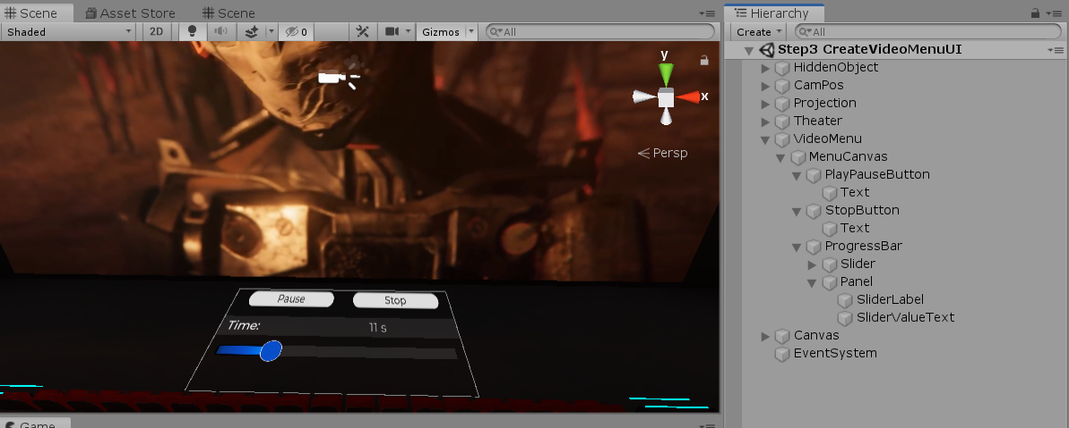
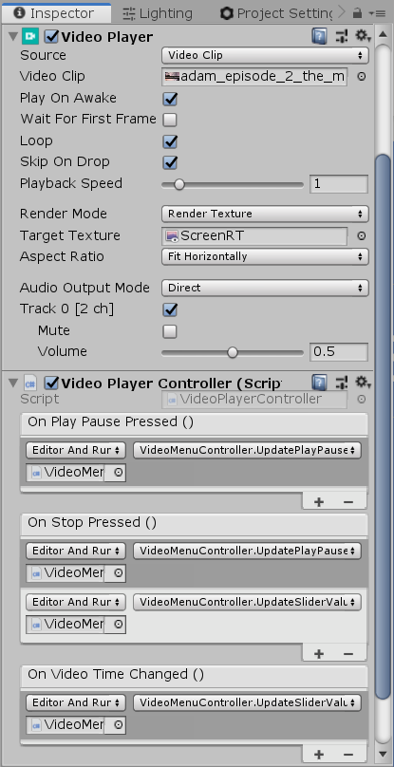
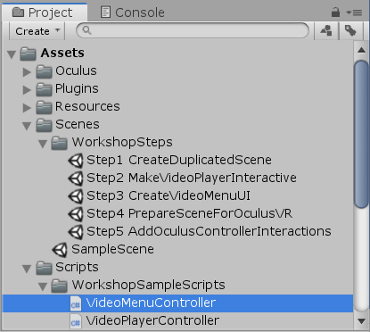
3.
Setting-up the video player UI
35 minutes
Notes:
Create Video Player UI and make it synchronized with the Video Player state.
- See DebugUI sample scene from Oculus package.
- Create VideoMenu empty object and child canvas with render mode World Space, X Rotation 90, Width 5, Height 3, positioned on the cinema stage.
- Create button with initial text “Play/Pause” and change Scale X to 0.005 Y to 0.01.
- Create button with text “Stop” and change Scale X to 0.005 and Y to 0.01.
- Create slider with label “Time:”, “Whole Numbers” checked and change Scale X to 0.01 Y to 0.015.
- Create VideoMenuController script that would handle the menu logic and would allow to show or hide the menu.
- Create UnityEvents in VideoPlayerController script that would inform the UI when video player is changed. Attach VideoMenuController methods to the created unity events.

Slide 14
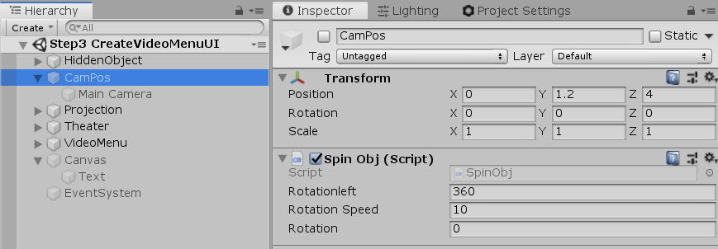
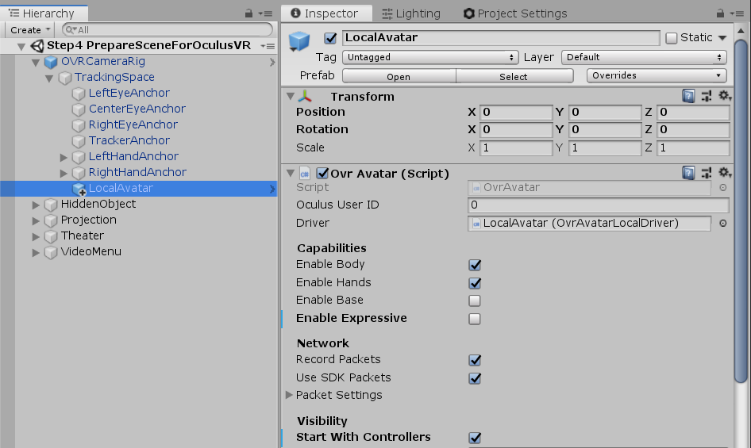
4.
Add OVR camera and local avatar
10 minutes
Notes:
Prepare scene with OVR camera and avatar:
- Remove non-VR elements from the scene – MainCamera, ScreenSpace canvas with “Rotate camera with…” text, EventSystem object.
- Add OVRCameraRig with similar transform as the former camera.
- Add LocalAvatar child checking “Start with Controllers” and unchecking “Enable Expressive”.
- Test the OVRCamera rotation when running the game view and holding the Ctrl button.

Slide 15
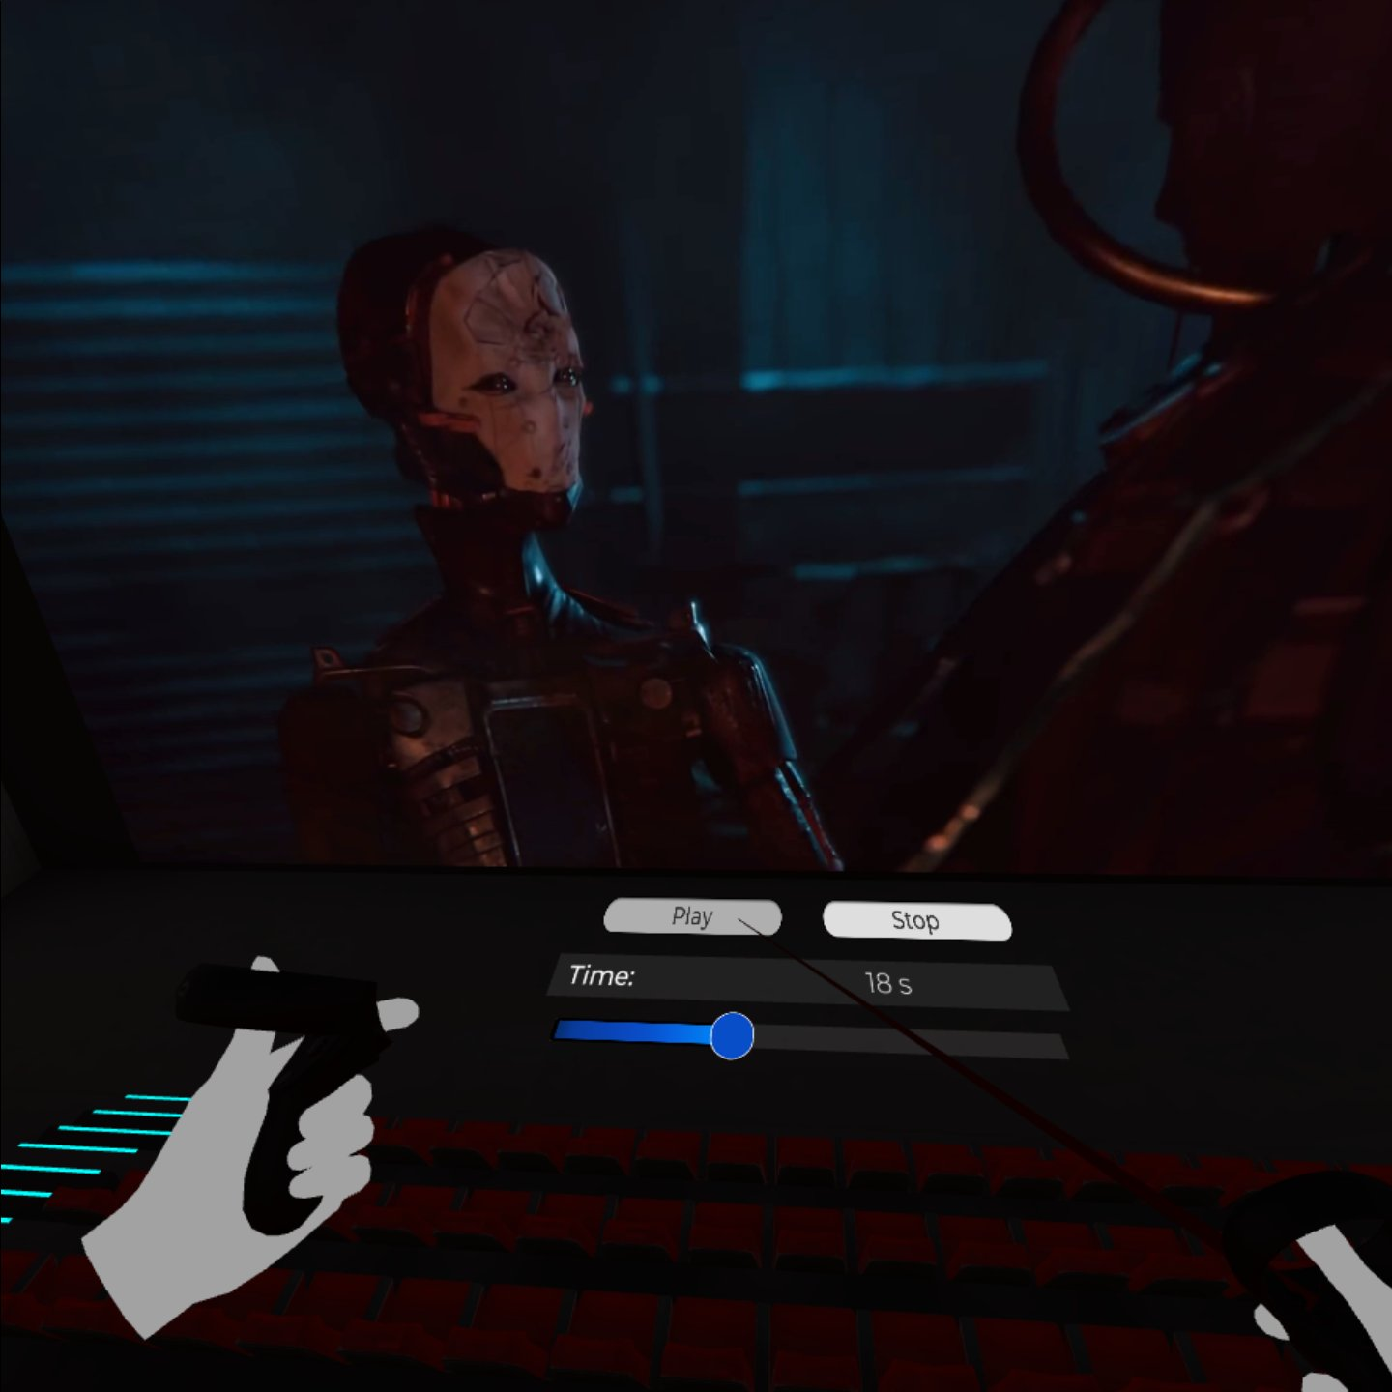
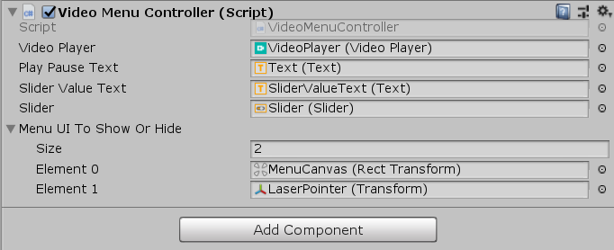
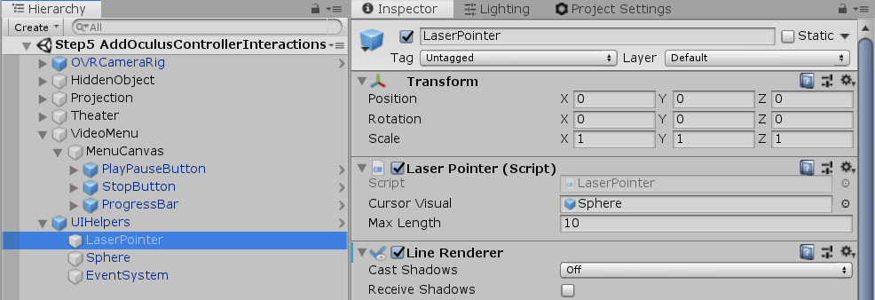
5.
Oculus controllers interactions
25 minutes
Notes:
Make controllers interact with the video menu with laser pointer, taking the idea from DebugUI Oculus sample scene.
- Instantiate UIHelper prefab in our scene initializing its fields and turning on the LaserPointer LineRenderer component.
- Modify MenuCanvas element by adding OvrRaycaster script with initialized Pointer field and by setting CenterEyeAnchor as event camera.
- Button click events should be initialized with appropriate PlayPause and Stop methods from VideoPlayerController script.
- Slider value change event should be initialized with the appropriate method from VideoMenuController script.
- Button Two of Oculus controllers should hide/show the video menu and the laser pointer.

Slide 16
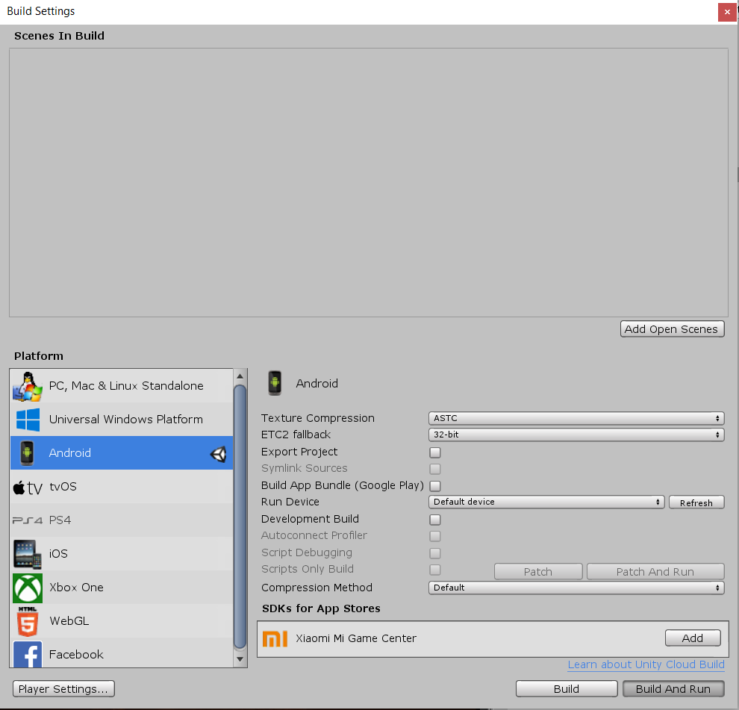
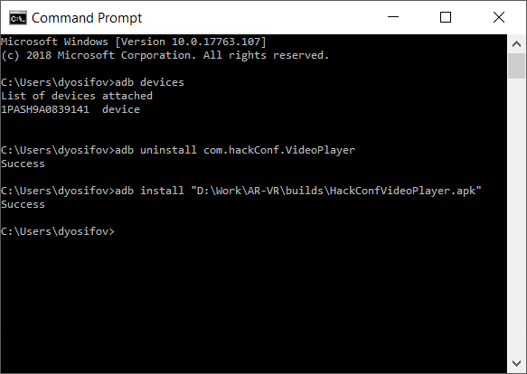
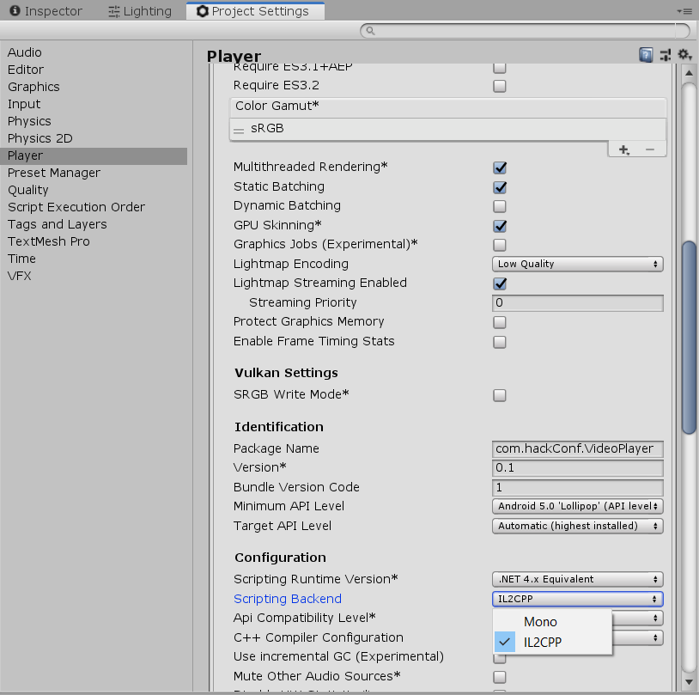
Build, deploy and test on a real device.
20 minutes
Notes:
- Build and deploy with and without the ADB.
- Mention difference between Mono and IL2CPP.

Slide 17
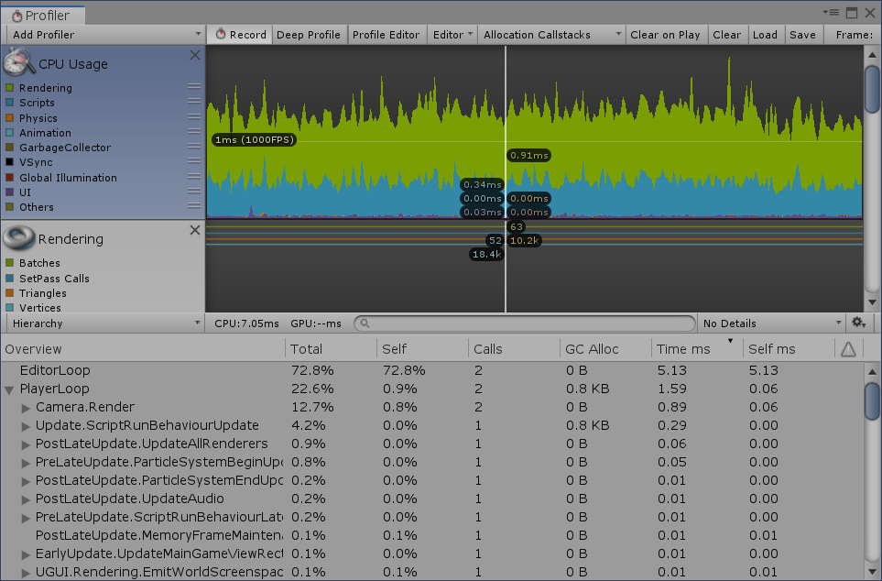
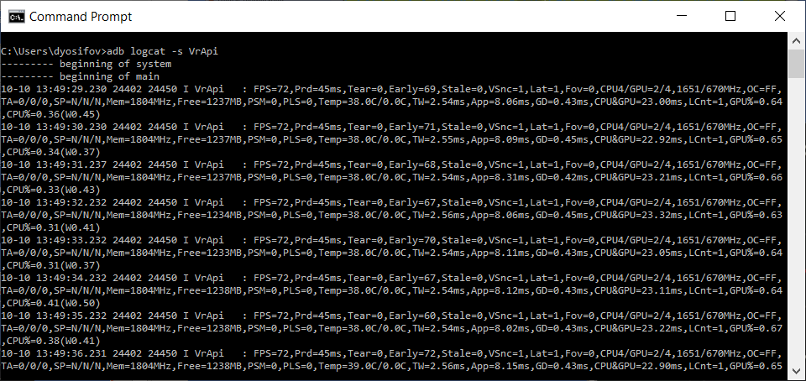
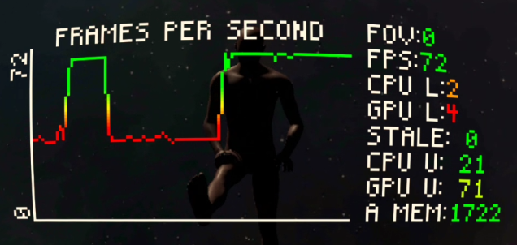
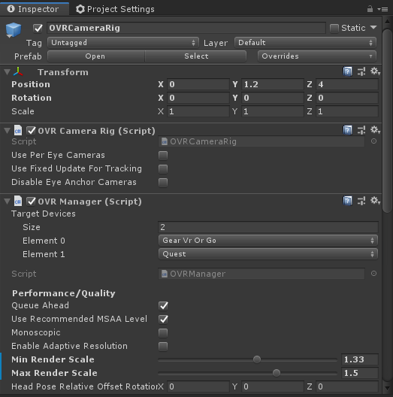
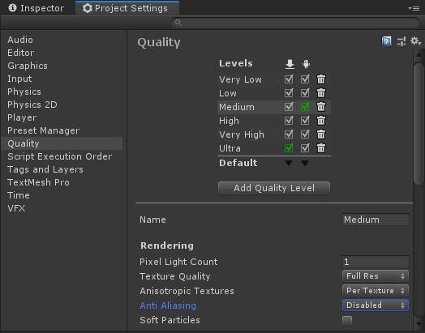
Fine-tune for performance and quality
15 minutes
Notes:
Show Unity profiler, OvrMetricsTool, logcat profiler.
Show QualitySettings Anti Alising and OvrCameraRig Render Scale.

Slide 18
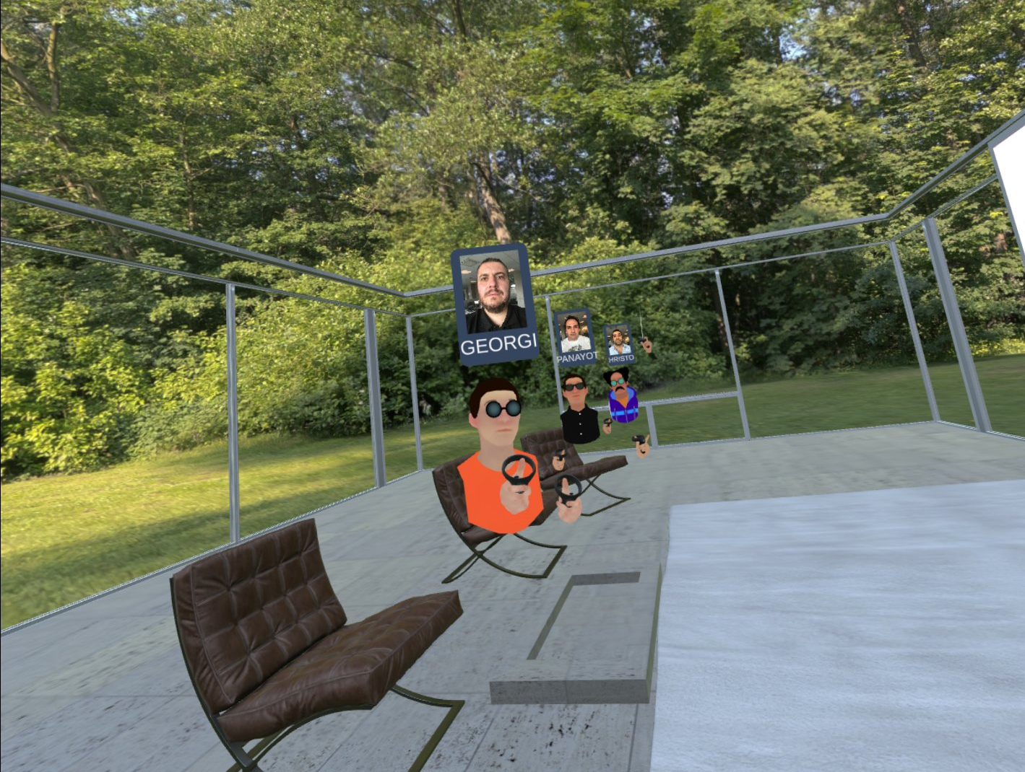
What’s next – Multiplayer, Avatars, VoIP
10 minutes
Notes:
Explain what can be achieved with the current technologies.

Slide 19

Thank YOU!
Georgi Atanasov | @atanasovg
Panayot Cankov | @PanayotCankov
Deyan Yosifov | @deyan_yosifov
Hristo Zaprianov | @ZapFanatic

